Slide 1
WSO2 IDENTITY SERVER
OPEN SOURCE IDENTITY AND ACCESS MANAGEMENT FOR AN
AGILE BUSINESS

Slide 2
Intro to WSO2

Slide 3
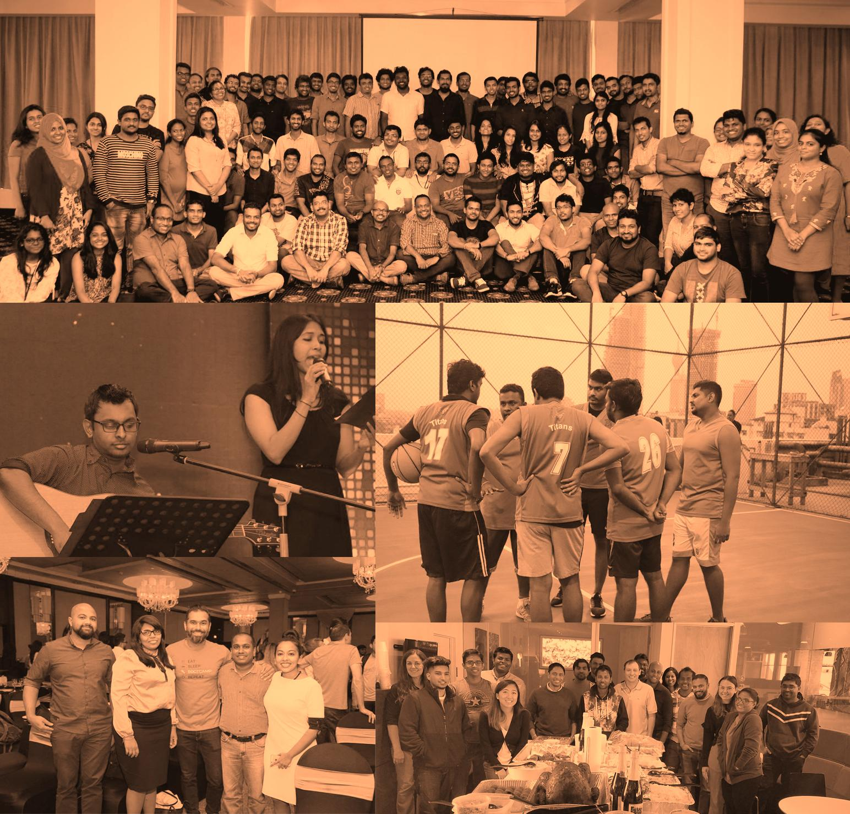






500+ Customers
175 New in 2018
550+
Employees
(300 Engineers)
Founded 2005, Backed by Cisco and Toba Capital
Open
Source
Colombo, New York, London, Mountain View, São Paulo, Sydney
$37m in 2018 Subscriptions
53% YoY growth

Slide 4



Integrated, Open Source Products Common architecture, common code base
ENTERPRISE INTEGRATION Quick, iterative integration of any app, data, or system
IDENTITY & ACCESS MANAGEMENT
Secure and federated identity for integration
API MANAGEMENT API design, creation, reuse, governance, and analytics
6 trillion transactions / yr
100M identities managed
20K APIs connecting
200K orgs
Hybrid integration platform for quick, iterative integration of any application, data, or system.
Data integration
ESB
Integration designer
Message broker
Workflows
Federates and manages identities across both cloud service and enterprise environments
Identity Federation and SSO
Identity Bridging
Strong and Adaptive Authentication
Access Control
APIs and Microservices security
Privacy
Account Management and Identity Provisioning
Addresses full API lifecycle management operations. Open, extensible, customizable.
API analytics
API designer
API gateway
API microgateway
API publisher
API storefront/marketplace
API repository/registry

Slide 5
WSO2 Identity Server

Slide 6
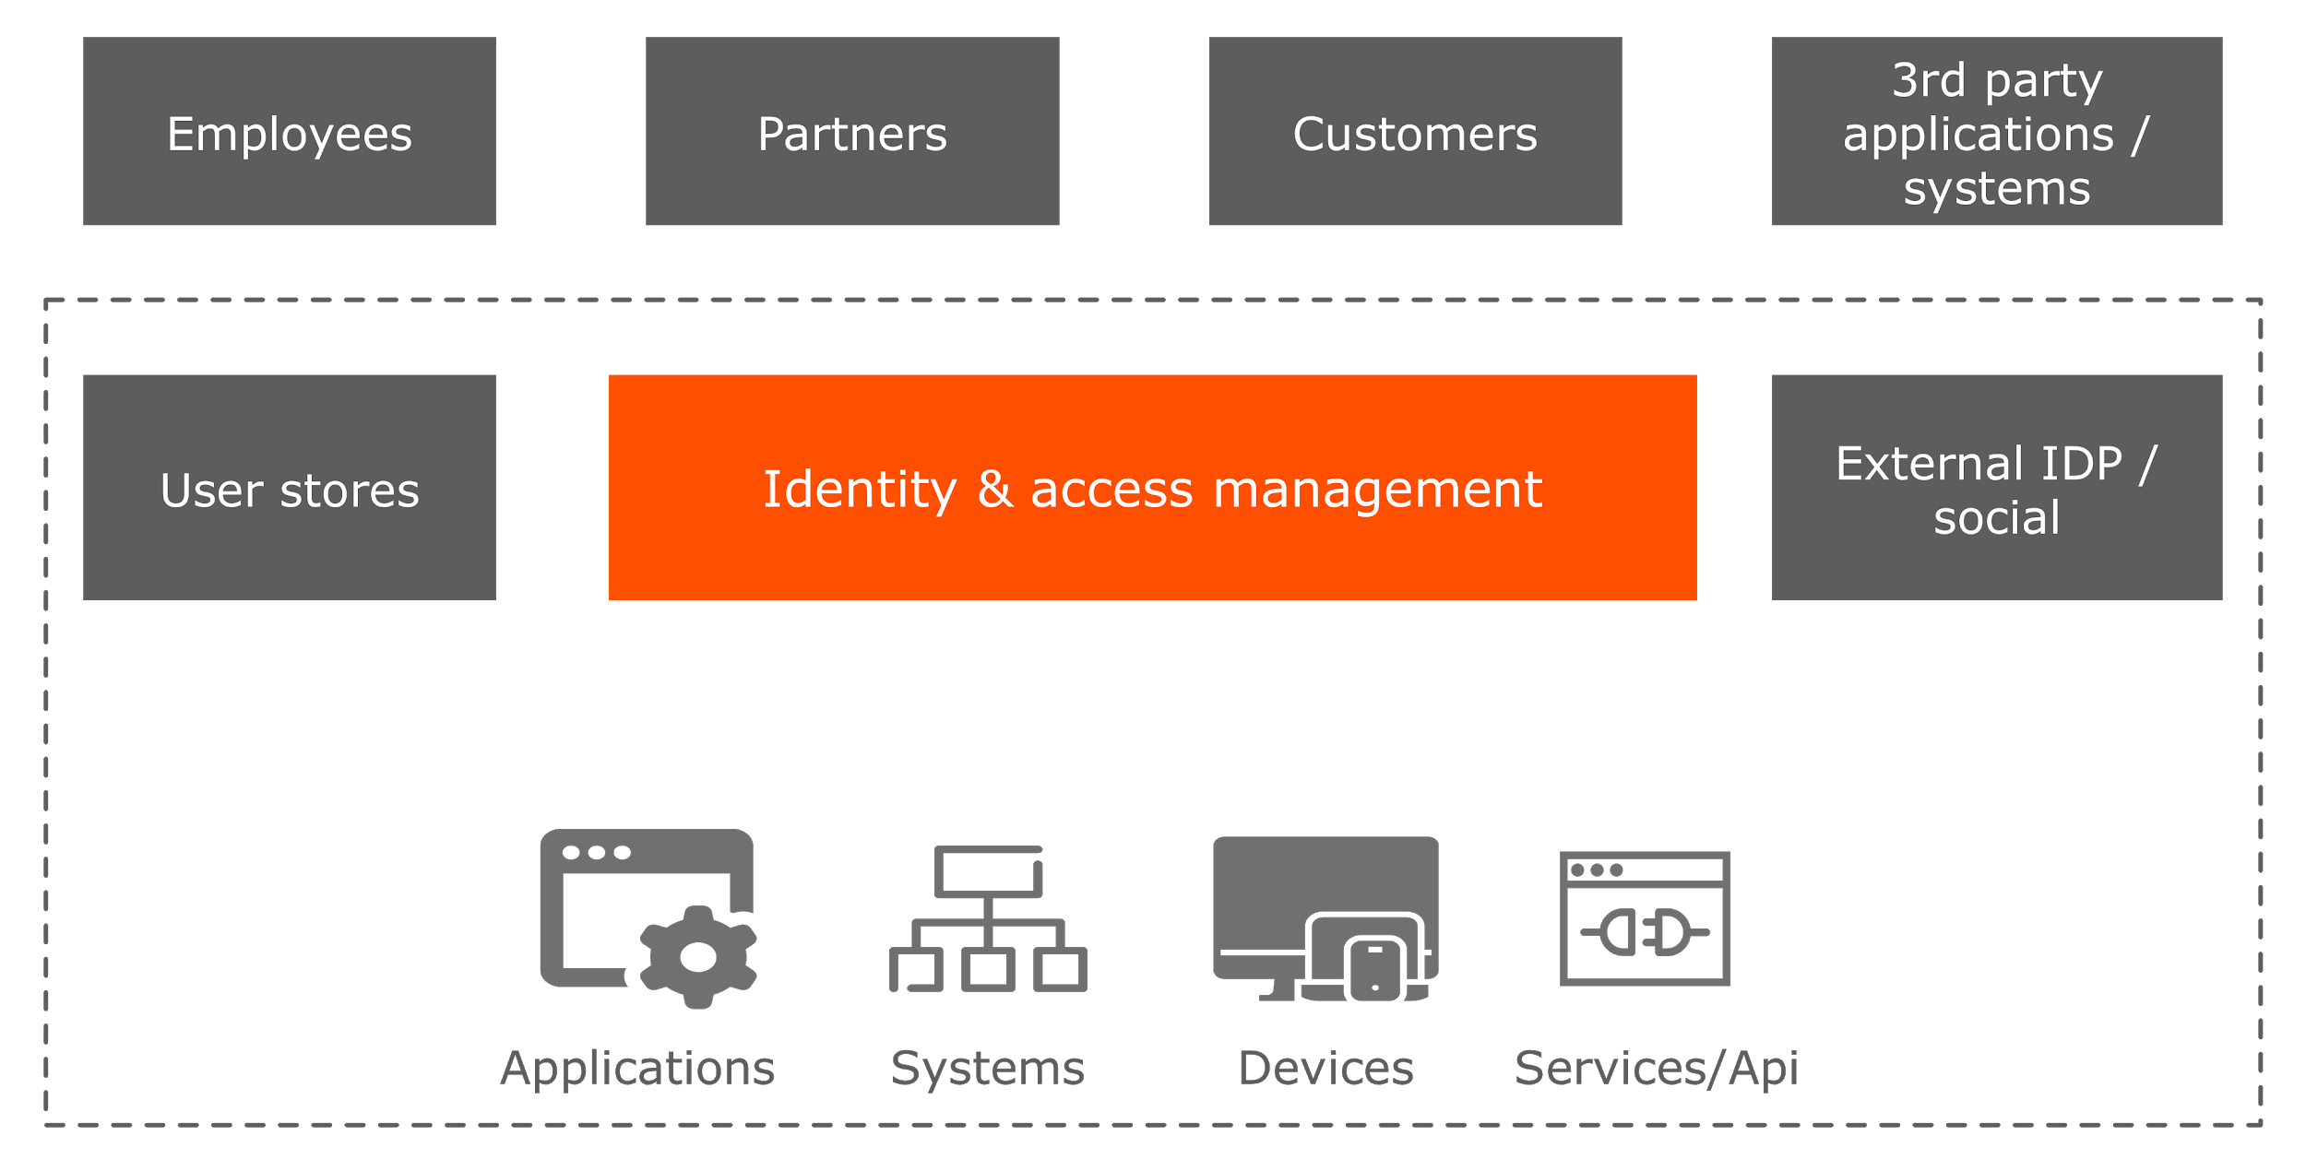
IAM WITHIN A DIGITAL ENTERPRISE
Notes:
here we need to talk a bit about what it means to be a organization that’s in the age of the consumer.
Basically this means at present the businesses are tuning to what consumers need. The feedback cycle is very fast. Business are exposed to alot of tools to monitor the consumers. Like location tracking, buying patterns etc.
Businesses are using many different ways to be close to the consumer. Mobile / alexa / google home / TV etc. So the consumers challenge the businesses to do new things and follow them.

Slide 7
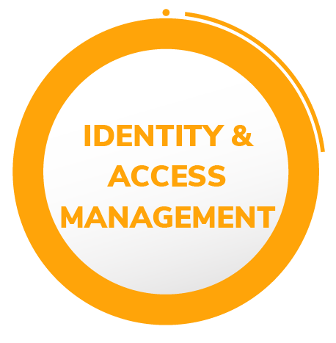
IAM IN DIGITAL TRANSFORMATION
Connect everyone to digital assets securely, with correct level of access control
Source of competitive differentiation
Increases business agility
Secure all aspects of your brand
Easy access anywhere, anytime
Enhance user experience
Notes:
here we need to talk a bit about what it means to be a organization that’s in the age of the consumer.
Basically this means at present the businesses are tuning to what consumers need. The feedback cycle is very fast. Business are exposed to alot of tools to monitor the consumers. Like location tracking, buying patterns etc.
Businesses are using many different ways to be close to the consumer. Mobile / alexa / google home / TV etc. So the consumers challenge the businesses to do new things and follow them.

Slide 8
IAM VALUE PROPOSITION
What can an organization expect out of IAM
Business insight
Business relationships
Business agility
Security
Service delivery
Compliance
User productivity

Slide 9
IAM vs CIAM
APIs and Integration
How to integrate with multiple data sources, CRM systems, marketing platforms/solutions, e-commerce platforms, fraud detection solutions, risk engines, content management systems, data management platforms and many more.
Scalability
Auto-scaling - containers/Docker/K8S
Vertical / Horizontal scaling
Strong / Adaptive Authentication
Analytics
Security and Privacy

Slide 10

About WSO2 Identity Server
Fully Open Source (Apache 2.0 open source license)
Inherent extensibility for building tailor-made IAM platform
100+m identities managed worldwide
150+ production customers globally and 500+ educational institutes
24*7 support for the production customers
Globally operating - main offices in USA, UK, Germany, Brazil, Australia, and Sri Lanka
Overall in LC: Identity API platforms
Product leader in LC: Access Management and Federation
Innovation leader in LC: CIAM

Slide 11
What
One Platform for All Identity Needs
WSO2 Identity Server is an open source IAM product that federates and manages identities across all enterprise and cloud service environments.

Slide 12
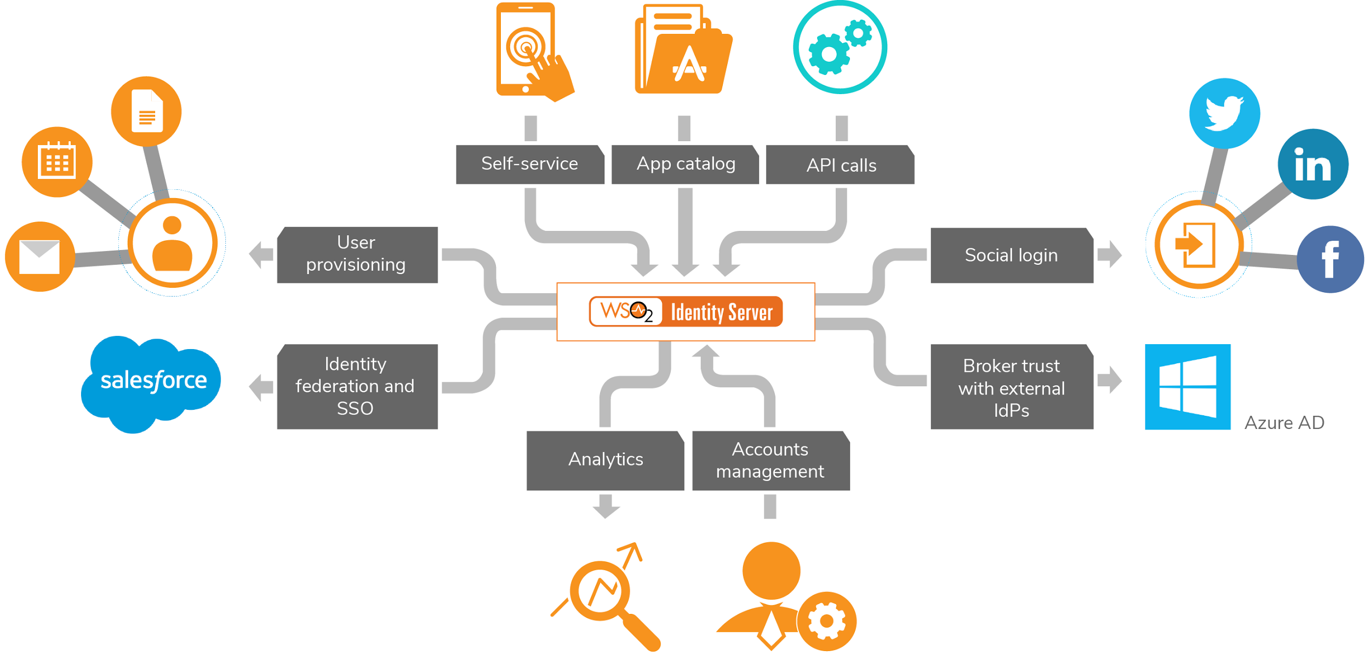
WSO2 IDENTITY SERVER FEATURES
Notes:
here we need to talk a bit about what it means to be a organization that’s in the age of the consumer.
Basically this means at present the businesses are tuning to what consumers need. The feedback cycle is very fast. Business are exposed to alot of tools to monitor the consumers. Like location tracking, buying patterns etc.
Businesses are using many different ways to be close to the consumer. Mobile / alexa / google home / TV etc. So the consumers challenge the businesses to do new things and follow them.

Slide 13
FOCUS AREAS OF WSO2 IDENTITY SERVER
One Platform for All Identity Needs
SSO & Identity Federation
Strong Authentication
Account Management and Identity Provisioning
Access Control
Privacy
API and Microservices Security

Slide 14
HIGHLIGHTS OF WSO2 IDENTITY SERVER
Open source: Ensures no vendor lock-in and maintains low costs of ownership
Highly extensible: Rich connector store for extensions (40+ connectors)
Support for open standards in SSO, Authentication and access control
Accommodating large scale deployments over millions of users (50mn+)
Built-in support for social logins and strong authentication systems
Easy and flexible deployment

Slide 15
Product Features
Notes:
Which also provides a framework for further customization and extension.

Slide 16
SSO & Identity Federation
Notes:
Which also provides a framework for further customization and extension.

Slide 17
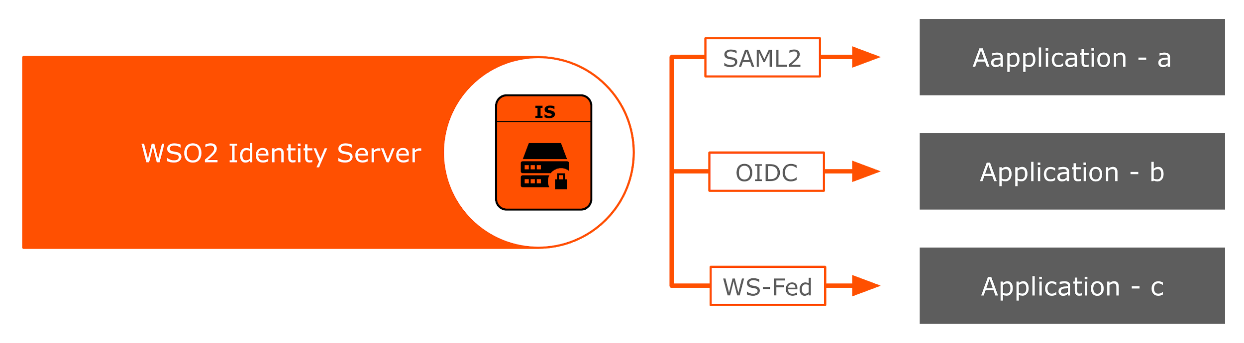
SSO & FEDERATION
Multiple Heterogeneous Identity Federation Protocols
Business users need to access multiple heterogeneous applications.
Cloud / on-prem
Different implementations
Different SSO protocols
User identities are federated between IdPs and applications over standard protocols
Notes:
The SAML2 implementation is eIDAS compliant - PSDA (implemented for PSDA in Georgia)
OpenID Connect Suite 1.0 Profile compliant (certified currently for only basic and implicit, but compliant with hybrid, config, dynamic and form post as well.)
WSO2 Telco Solution (MCX) - https://www.readme.lk/wso2-telco-joint-venture/ - WSO2.Telco powers mobile authentication services for 800 million consumers in India, served by 6 leading MNOs, namely Aircel, Bharti Airtel, Idea, Tata Teleservices Ltd, Telenor and Vodafone.
SSO works across protocols.
Single Logout (SLO) across protocols is supported from IS 5.8.0 (need to confirm version) onwards. Along with this even users can trigger single logout requests to all the service providers for their own sessions or admins on behalf of user sessions.
Although “conditional login to service providers” using XACML (slide 37) is under “authorization” section, the operation is triggered during SP-IdP federation flow.

Slide 18
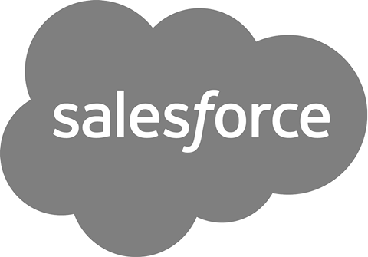










ARCHITECTURE
Inbound Authenticators
Authentication framework
Federated Authenticators
Request processor
IN
SAML SSO
Service providers
SP to Local
Claims Mapping
Local to IdP
Claims Mapping
OAuth
External Apps
SAML SSO
OpenID-connect
OAuth
OUT
Passive STS
OpenID-connect
Local to SP
Claims Mapping
IdP to Local
Claims Mapping
JIT Provisioning
Facebook
Passive STS
Yahoo
Response generator
Google
Microsoft
Username /
Password
Provisioning Framework
Inbound Provisioning
Outbound Provisioning
IWA
Google Apps
SCIM
Local Authenticators
SCIM
SOAP
User Store Manager
SOAP
Salesforce
Google
LDAP
AD
JDBC
Notes:
here we need to talk a bit about what it means to be a organization that’s in the age of the consumer.
Basically this means at present the businesses are tuning to what consumers need. The feedback cycle is very fast. Business are exposed to alot of tools to monitor the consumers. Like location tracking, buying patterns etc.
Businesses are using many different ways to be close to the consumer. Mobile / alexa / google home / TV etc. So the consumers challenge the businesses to do new things and follow them.

Slide 19
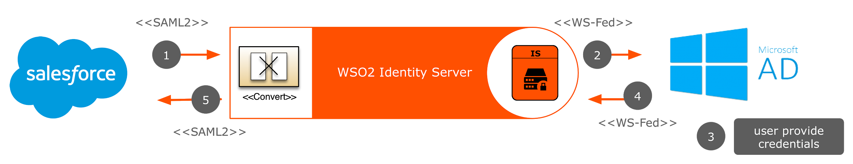
IDENTITY BUS
Outbound Authentication Requests to External Parties
Authenticate users from trusted identity providers to applications
User story - Authenticate users from ADFS to Salesforce
Role & claim transformation
External IdP configured through federated authenticators
Notes:
Why Identity Bus?
There are many identity domains in an organization that operate on different protocols
When it is possible for users to login using their identity from a different domain into this domain there is seamless Identity federation between different identity domains.

Slide 20
EXTENSIBLE IDENTITY FRAMEWORK
Extensible Architecture
More than 40+ different extension connectors
Inbound and outbound authentication
Just in time provisioning for inbound authentication flows
Multi-user store integration
Nearly 50 Authentication Connectors & Provisioning Connectors at WSO2 store
Notes:
here we need to talk a bit about what it means to be a organization that’s in the age of the consumer.
Basically this means at present the businesses are tuning to what consumers need. The feedback cycle is very fast. Business are exposed to alot of tools to monitor the consumers. Like location tracking, buying patterns etc.
Businesses are using many different ways to be close to the consumer. Mobile / alexa / google home / TV etc. So the consumers challenge the businesses to do new things and follow them.

Slide 21
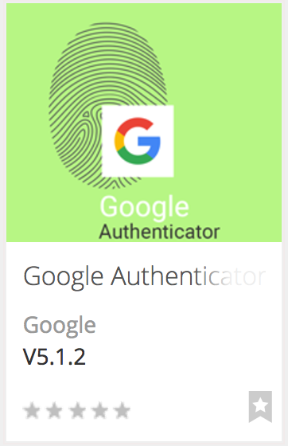
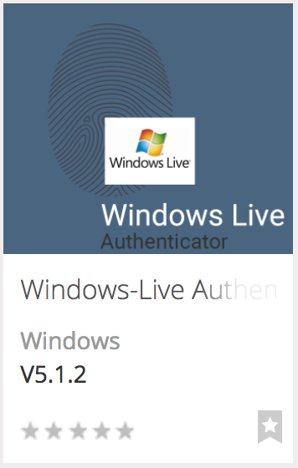
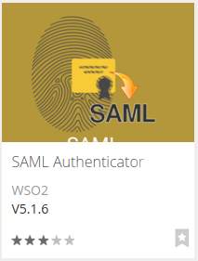
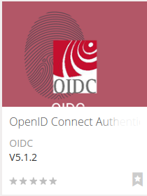
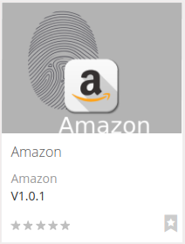
FEDERATED AUTHENTICATORS
Connectors from the WSO2 Store
Authenticate with external SaaS, IDaaS platforms
No additional cost. Download and Install
https://store.wso2.com/store/assets/isconnector/list
Notes:
Connectors facilitate the solution with connectivity and easy integration with the common enterprise applications and platforms
WSO2 connectors do not come with an additional cost
The connector framework is extensible

Slide 22
Demo
SSO with WSO2IS
Login to Salesforce with WSO2 Identity Server
Login with Facebook account

Slide 23
WSO2 Features in the demo
SSO with WSO2 IS and Identity Federation
Login to Salesforce with WSO2 IS
Login with Facebook account
Multi Factor / Multi Option Authentication
Adaptive Authentication
JIT Provisioning
Notes:
here we need to talk a bit about what it means to be a organization that’s in the age of the consumer.
Basically this means at present the businesses are tuning to what consumers need. The feedback cycle is very fast. Business are exposed to alot of tools to monitor the consumers. Like location tracking, buying patterns etc.
Businesses are using many different ways to be close to the consumer. Mobile / alexa / google home / TV etc. So the consumers challenge the businesses to do new things and follow them.

Slide 24
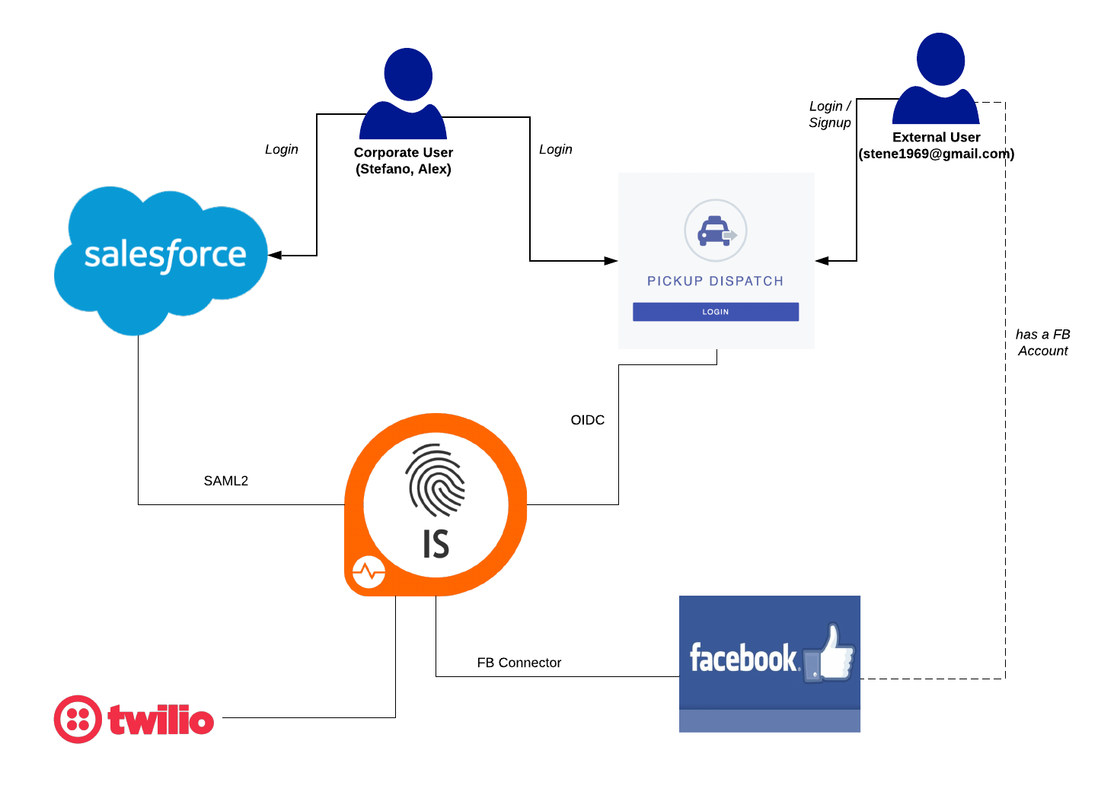

Slide 25
Strong and Adaptive Authentication
Multi-Factor & Multi-Option Authentication

Slide 26



MULTI-STEP & MULTI-OPTION
Multi-Step : Add any number of authentication steps
Multi-Option : Add any number of authenticators for a step
Configuration per application
Local and federated authenticators
Local: Basic / IWA (zero password login) / FIDO (First Identity Online)
Federated: SAML2/ OIDC / MePIN / Email OTP / SMS OTP / Duo security
Notes:
here we need to talk a bit about what it means to be a organization that’s in the age of the consumer.
Basically this means at present the businesses are tuning to what consumers need. The feedback cycle is very fast. Business are exposed to alot of tools to monitor the consumers. Like location tracking, buying patterns etc.
Businesses are using many different ways to be close to the consumer. Mobile / alexa / google home / TV etc. So the consumers challenge the businesses to do new things and follow them.

Slide 27
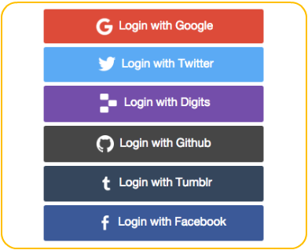
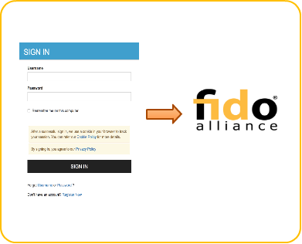
Static Authentication Sequence
Multi-step Multi-option

Slide 28
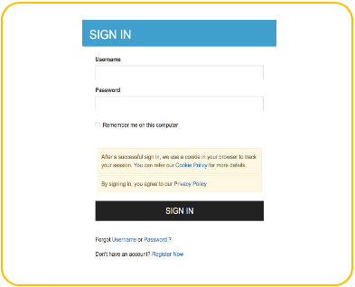
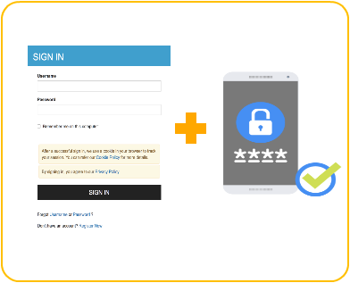
Request-Based Step-up Authentication
View balance Fund transfer

Slide 29
Demo
Secure Access with Multi-Factor Authentication (SMSOTP)
Adaptive Authentication

Slide 30
Account Management and Identity Provisioning
Identity Layer of the Digital Enterprise

Slide 31
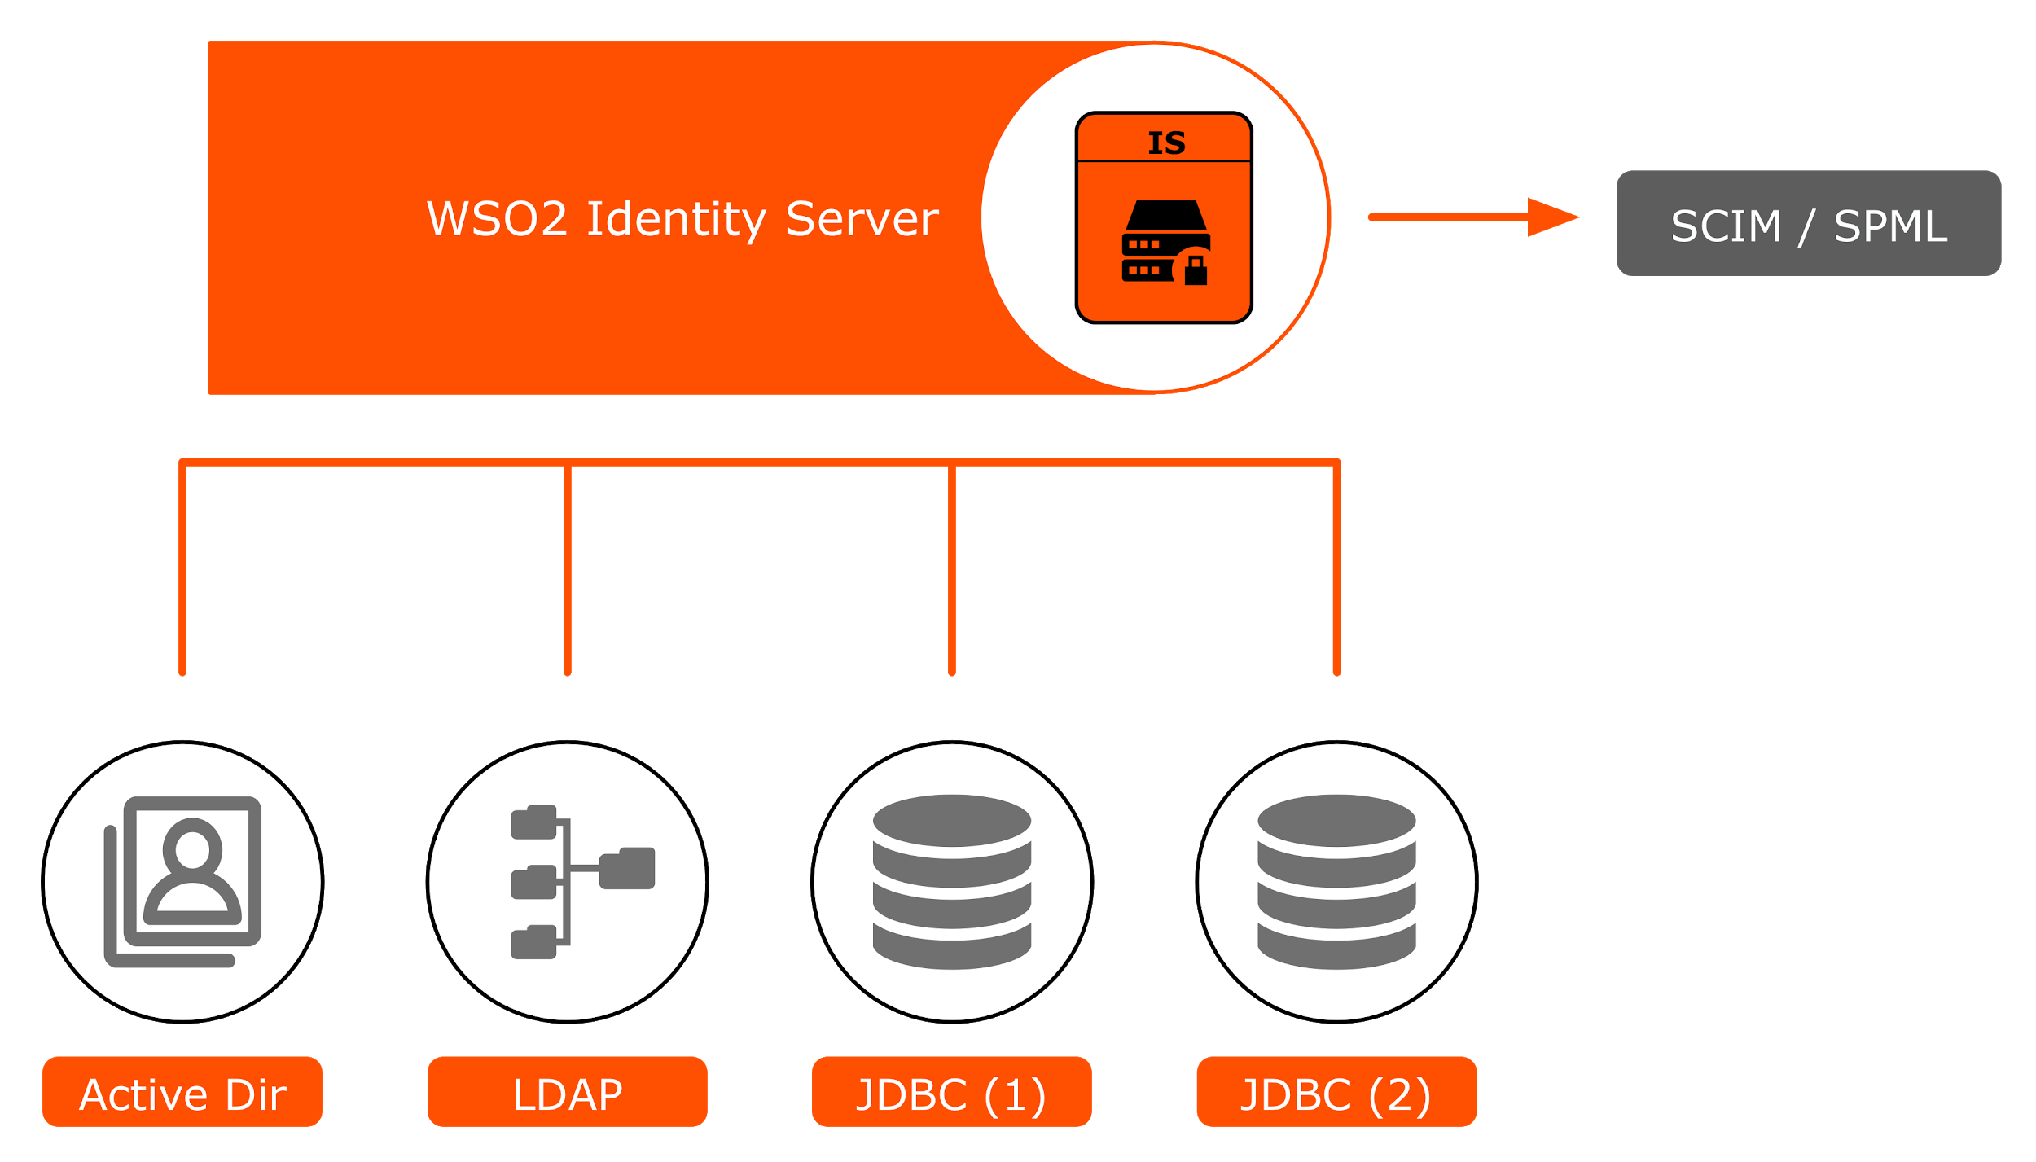
IDENTITY INTEGRATION
Multiple Identity Stores in Read/Write Mode
Multi-tenant identity layer. Native support for SaaS deployments
Support for primary and multiple secondary user stores
Provisioning via SCIM
Notes:
User Store - logical representation of a physical user directory.
Server cannot be started without a primary user store.
Primary user store of the super tenant is where the admin user defined in user-mgt.xml resides.
Primary user store of super tenant is physically shared with the tenants.
For JDBC User Store we qualify each record with a tenant ID. For LDAP directories we create a child organization inside the root organization for each tenant that will contain the users and groups of the particular tenant.
Each tenant can have multiple secondary user stores of its own; each secondary user store is logically associated to a tenant.
Admin role consists of all permissions in the system.
If the user store is read-only, the admin user is expected to be existing. If not the server throws a startup error. The admin role would however be created in the Internal user store.
MD5, SHA1, SHA256 and SHA512 hashing algorithms can be performed by IS for password hashing. Optionally for JDBC user stores, IS can do salting as well. If the user store can support hashing and/or salting by itself, IS can work with plaintext and delegate the hashing and/or salting to the user store.
Custom user store use cases:
Local account linking -
Account merging - Single user’s profile spanned across 2 user accounts - implement a custom user store manager to aggregate profiles from 2 separate user accounts and show them as part of a single identity through the API and in the UI. This technique can be used as a way to implement multiple user profiles for a single user.
A user must authenticate with username/password in secondary user store and fetch attributes from primary user store and return back to the service provider. This is also a form of account merging.
Single physical user having more than one user account in the system, wants to link them all, make one account as the primary login account and link the remaining accounts to the primary account to create a larger profile. This is not account merging, rather account linking.
A user can have multiple accounts in the local user store. Same user also has a federated identity. The user should be able to link the federated identity to both the local identifiers. When logging in the user will choose, federated login and then on IS choose which local identity to login as. This is also an example of account linking.
Examples:
“UC - WSO2 Identity Server Opportunity | BankID Connector” in pre-sales-group@wso2.com
Unsupported password hashing/salting algorithms especially in JDBC user stores.
Multiple credentials (password, passphrase, PIN, etc.)
Shared user base across tenants (Exfo)
Authentication behavior:
User store chaining
Short-circuiting
SCIM2 is our recommendation for consuming identities over APIs. SCIM 1.1 is supported but not actively developed anymore. Don’t recommend SOAP as well unless there is a good reason.
SCIM2 allows supports
Create and List on /Users
Read, Update & Delete on /User/{id}
Creat
e and List on /Groups
Read, Update & Delete on /Group{id}
Create, Read, Update on /Me
Create, Read, Update & Delete on Bulk user endpoint to minimize network overhead
Rest APIs in IS are protected by “Rest API Access Control” layer. All Rest APIs in IS are currently protected by this layer. Can support any custom Rest API as well.
This layer allows pluggable authentication and authorization methods.
Authentication methods supported out-of-the-box are - Basic, Mutual TLS, OAuth2, JWT
Authorization method supported out-of-the-box is role based (permissions).
NoSQL User Store - MongoDB connector available but not in production at any customer, performance tests have to be done. So far we haven’t seen a convincing requirement for NoSQL databases.
We don’t support hierarchical/nested groups out-of-the-box. However, we have implemented a extended User Store which supports Nested Groups only at the LDAP level and expose this custom implementation as an API for Petrolink. Same feature was requested by GE Healthcare as well.
We don’t support group attributes.
We don’t support group metadata.
Although it is decided that in-JVM multi-tenancy will be removed from API Manager and EI it is still not concluded for IS. IS needs to support the concept of organizations in some form or the other. Currently multi-tenancy is what resembles this very closely.
Al-Elm (Saudi Arabia) - 4M+ users; 4 instances; MSSQL user store
State of Arizona - CIAM and workforce IAM; MSSQL and Active Directory user store
Seagate - 1M+ users/customers; Oracle DB user store
Trimble - 2M+ users/customer; OpenLDAP user store with 40+ service providers.

Slide 32
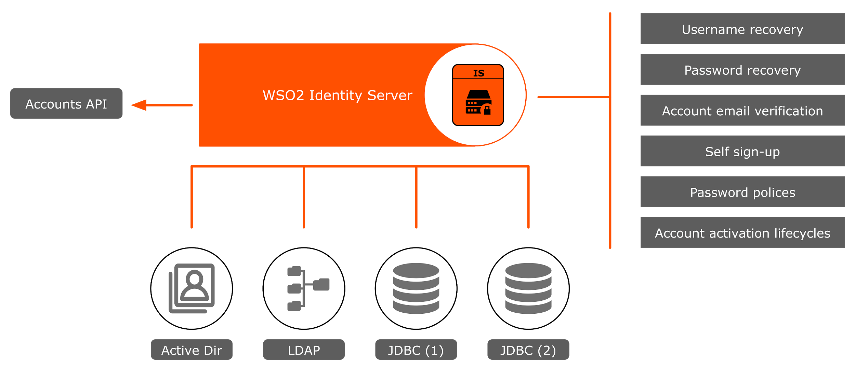
ACCOUNT AND CREDENTIAL MANAGEMENT
Account Setup / Approvals / Account Lifecycle Management

Slide 33
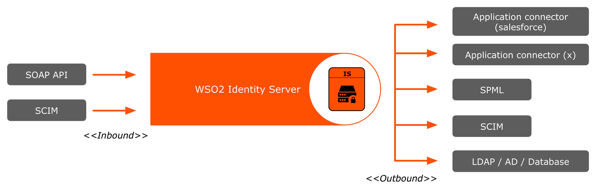
PROVISIONING
Inbound and Outbound Provisioning
Users can be provisioned into the WSO2IS (inbound)
Users can be provisioned to external systems (outbound)
Supports SOAP API and SCIM 1.1 for inbound
Support for many outbound provisioning connectors

Slide 34
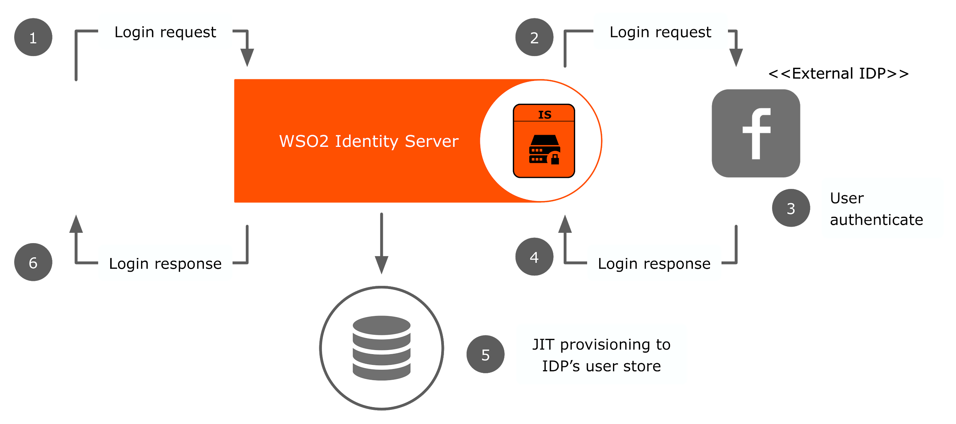
PROVISIONING
Just in time user creation
Provision users at the time of federated authentication
User story - A Company website wishes to have social login. But wishes to add the users to the local LDAP userstore
The IdP can be configured as prefered

Slide 35
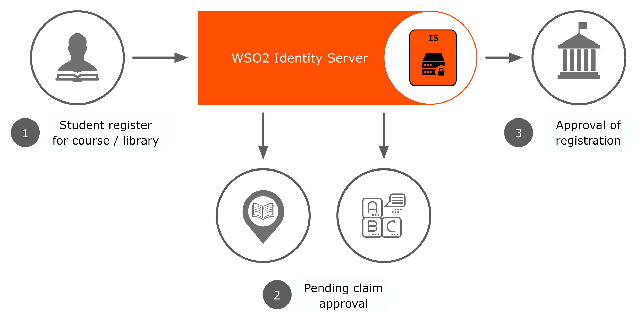
INBUILT WORKFLOWS
Inbuilt, Configurable Workflows
Driven by configuration that is done on events
Multi-step approvals that require multiple roles
User story - When associating a student with a set of claims in a university IAM system, an approval must be obtained by the university administrators
Extensible - can be configured with external BPMN engine and custom flows

Slide 36
Access Control
Fine Grained Access Control

Slide 37
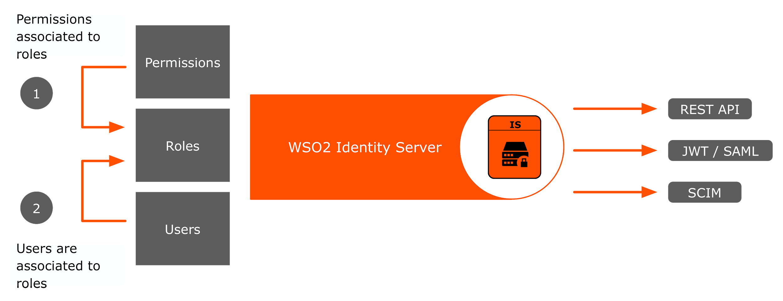
ROLE BASED ACCESS CONTROL (RBAC)
Access control through roles and permissions
Create permissions
Create roles
Assign roles to users
Role list is sent via SAML / JWT
SOAP APIs to authorize and manage
SCIM / REST API to list roles

Slide 38
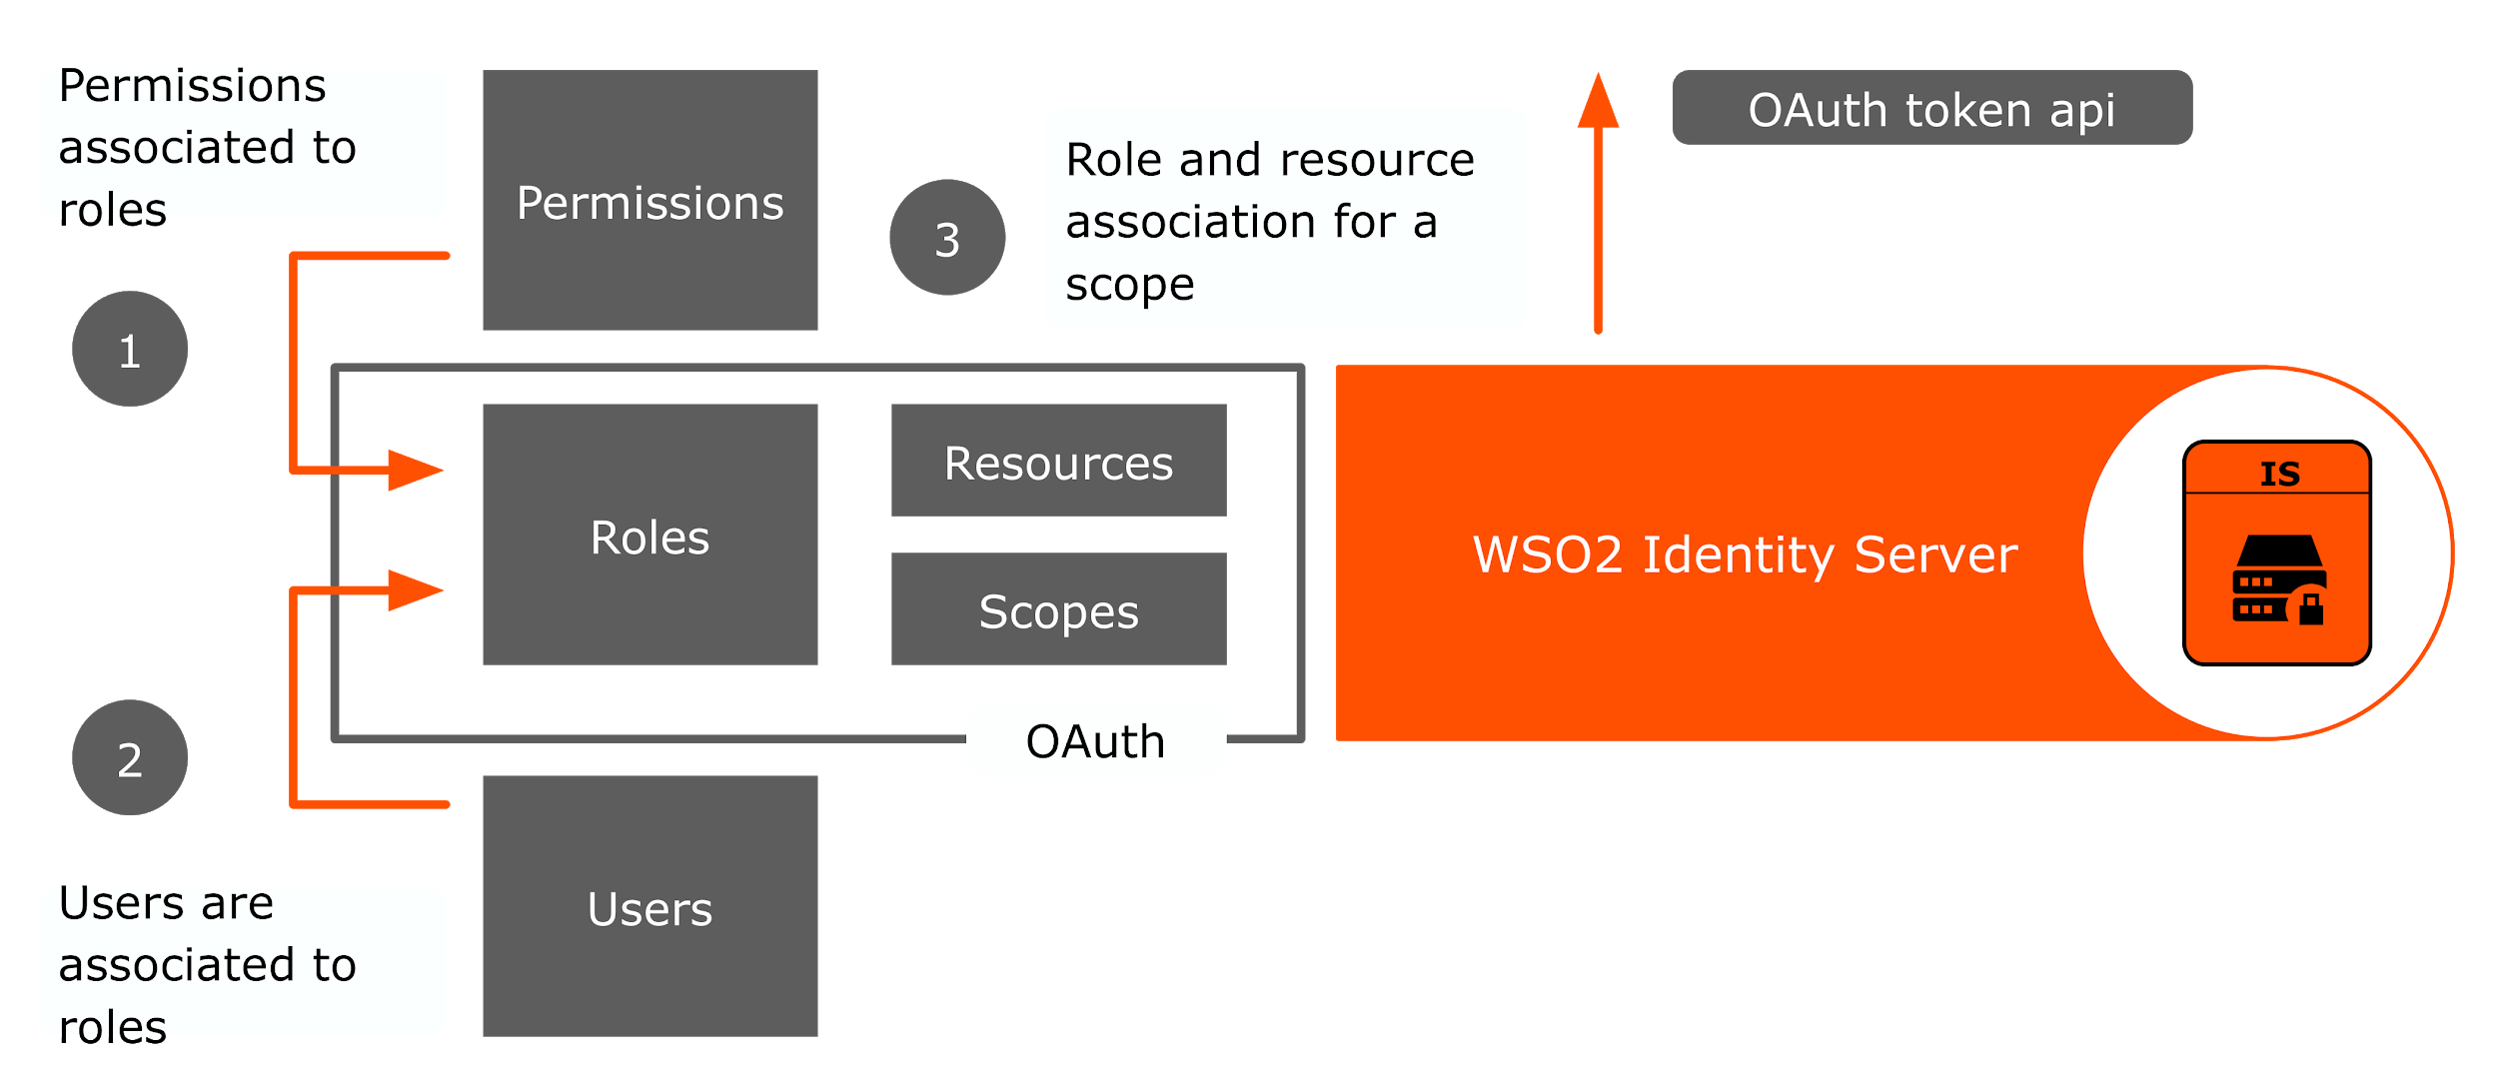
OAUTH SCOPE BASED ACCESS CONTROL
OAuth scope based authorization framework
Supports OAuth 1.0a and 2.0
Access token is validated over SOAP APIs as well REST APIs(OAuth2 introspection API)

Slide 39
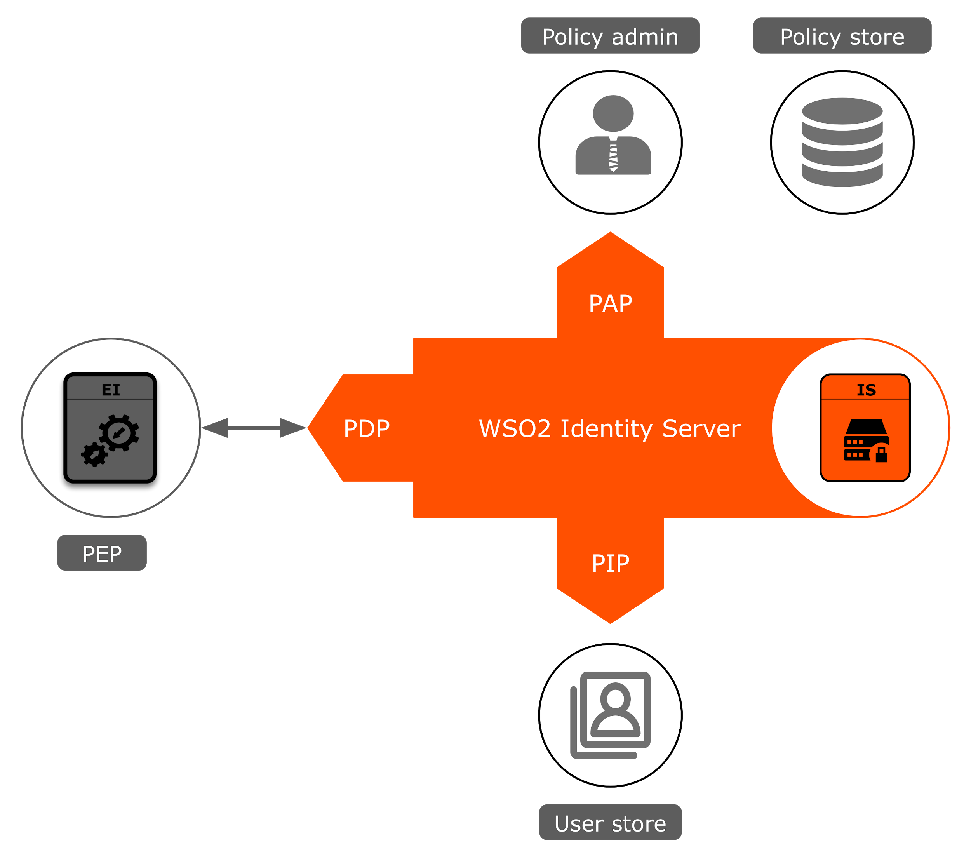
ATTRIBUTE BASED ACCESS CONTROL
Fine grained access control with XACML 2.0 and 3.0
Extensible
Plugin various PIP and PEP modules
Plugin policy stores
Manage policy via UI
Try-it tool for testing policies
Caching and Thrift transport for high performance

Slide 40
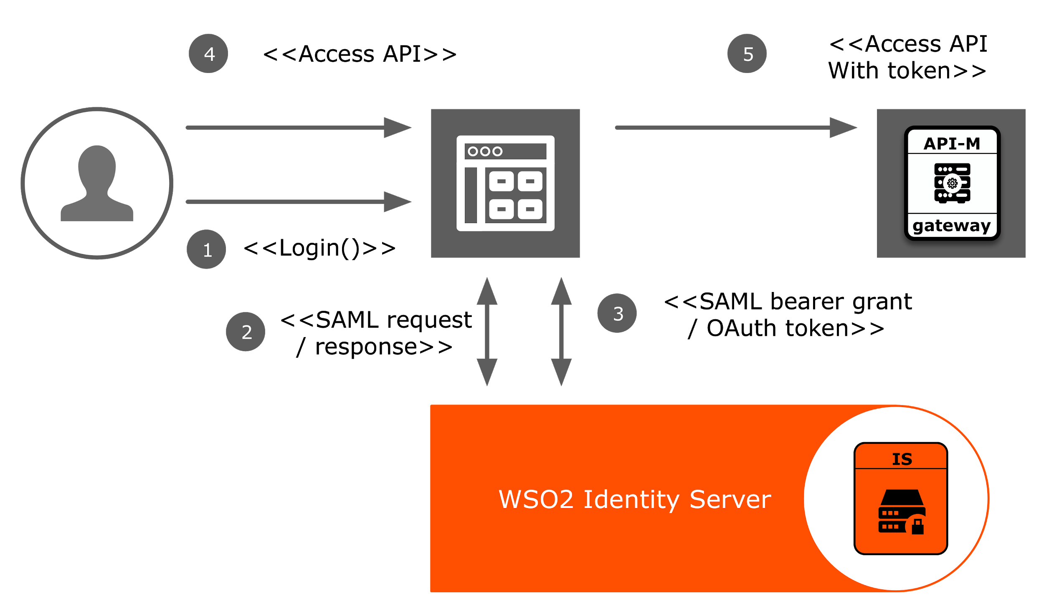
DELEGATED ACCESS CONTROL
Exchanging OAuth access token for SAML token

Slide 41
Privacy
For regulations such as GDPR

Slide 42
USER CONSENT MANAGEMENT
For Single Sign on - Provides users with choice and control over sharing their personal data.
For Self Sign up - Capability to provide consent when a user self registers to WSO2 Identity Server.
User Consent in OIDC - Integrating User Consent Management into OpenID connect Authorization Code and Implicit flow.
Consent purposes management - An interactive UI to manage consent purposes/PII categories.
Consent management API - Comprehensive RESTful API which supports Kantara consent management specification. With the use of this API, you can enable consent management for any application without being vendor lock.
Notes:
any self-care user profile creation, user provisioning to other systems, sharing user attributes through SSO and identity federation are fully based on user consent.
User can review, modify and revoke given consents via self-care user portal or via the RESTful Consent API.
Consent API can be also used to integrate WSO2 IS consent management capabilities with existing applications.
WSO2 IS can be used to manage consent of any 3rd party application via the RESTful Consent API.

Slide 43
PRIVACY TOOLKIT
Supports removing references to a deleted user's identity as and when required
Can be used to anonymize PII data scattered in databases connected to WSO2 Identity Server and scattered in log files.
Can be extended to support custom components deployed in WSO2 Identity Server

Slide 44
PERSONAL INFORMATION EXPORT CAPABILITY
Personal data export API can be used to download individuals profiles stored in WSO2 IS in a machine readable, structured and well known JSON format
Individual can download these profiles by login to self-care user portal or organization can facilitate individual by integrating existing applications/portals with RESTful Personal data export API exposed by WSO2 IS.
Notes:
.

Slide 45
Identity Analytics
Know what’s happening around you as and when it happens

Slide 46
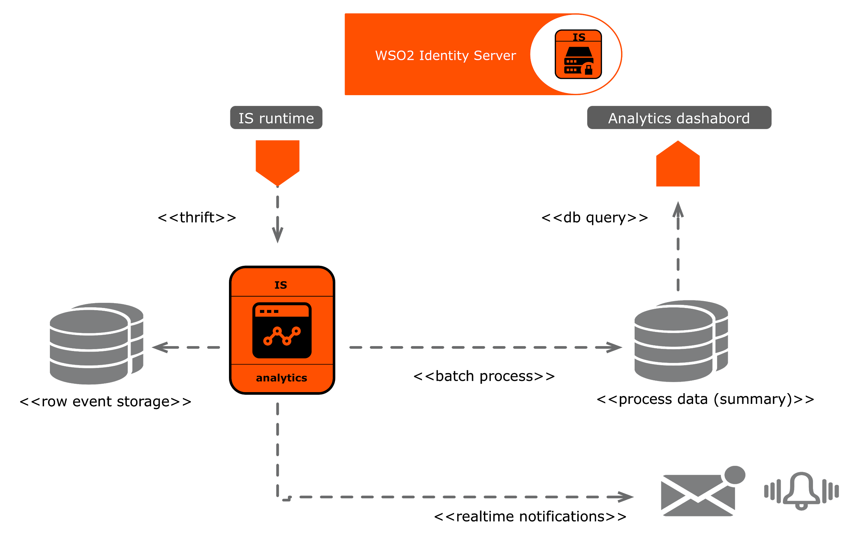
ANALYTICS, ALERTS & AUDIT-TRAIL
Dashboards for security analytics and monitoring

Slide 47
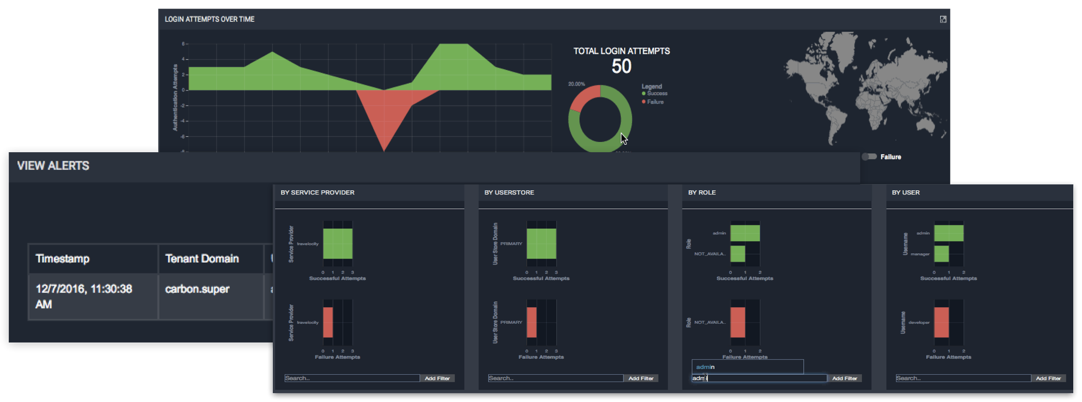
ANALYTICS, ALERTS & AUDIT-TRAIL
Dashboards for security analytics and monitoring

Slide 48
ANALYTICS, ALERTS & AUDIT-TRAIL
Dashboards for security analytics and monitoring
Analytics
Local login requests
Federated login requests
Logins by services provider
Alerts
Suspicious login attempts
Long session

Slide 49
Supporting Standards
Support for Open Standards

Slide 50
SECURITY STANDARDS SUPPORTED
Open Interoperability
SAML 2.0
OpenID/OIDC
SCIM
XACML
OAuth 1.0. and 2.0
OpenAz
WS-Security,WS-Policy and WS-Trust, WS-Federation
FIDO U2F,UAF

Slide 51
Securing APIs and Microservices

Slide 52
SECURING APIs
IAM role in API Management
Delegated access control using OAuth2 and WS-Trust
Support for SAML2 bearer grant type, JWT assertion grant type and NTLM-IWA grant type
OAuth2 token revocation support
OAuth token introspection
OAuth 2.0 form post response mode
Integrates with WSO2 API Manager for OAuth2 key management

Slide 53
SECURING MICROSERVICES
IAM role in Microservices
Increased attack surface
Authentication and authorization needed at each service
Each microservice is a responsibility of a single team → Data security is also their responsibility
Username/password is an option but self-signed JWT is better

Slide 54
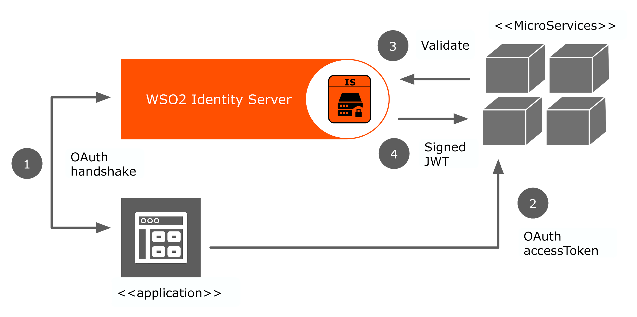
SELF-SIGNED JWT TOKENS FROM IDENTITY SERVER
OAuth 2.0 for Microservices

Slide 55
Product roadmap
Notes:
WSO2 Enterprise Integrator is The pure open source Integration product which is Comprehensive, Customizable and Extensible.
When thinking of your Tailormade integration solution in your story of Digital Transformation, WSO2 EI can be seen as the ideal product
Which supports the standard integration cases, enterprise integration standards
Which also provides a framework for further customization and extension.

Slide 56
WSO2 Identity Server Roadmap
Today
Near-Term
Future
SSO and Identity Federation
Support for open standards (SAML, OIDC, WS Federation)
Strong authentication (MFA), FIDO
BYOID
Authentication
Strong authentication with FIDO, Duo Security, mePin, RSA
Conditional authentication
Social login with Facebook, Twitter, LinkedIn
LDAP/AD/JDBC
Identity Administration
User onboarding
Identity provisioning
Group management and workflows
Security Token Service
OAuth 2.0 / JWT
Token Introspection
Dynamic Client Registration
Compliance
Privacy toolkit for GDPR
Consent management
eIDAS
SSO & Identity Federation
Identity Gateway
Authentication
Risk-based Adaptive Authentication
Environment-based Adaptive Authentication
User behavior-based Adaptive Authentication
User attribute-based Adaptive Authentication
WebAuth (FIDO 2.0)
Biometrics (integration with Veridium)
Security Token Service
Microprofile JWT
Token Exchange
Token Binding
UMA 2.0
Identity Administration
Identity Admin and user portal for improved user experience
Product APIs for cleaner integration
Identity Analytics
GDPR enhancements
SSO & Identity Federation
Proxy based federation
Authentication
Blockchain Integration
Ecosystem
Connectors to analytics, IGA, PAM solutions.
Notes:
No.1 open source identity federation
Q3 and Q4
Privacy
Adaptive authentication

Slide 57
A few Success Stories
Notes:
WSO2 Enterprise Integrator is The pure open source Integration product which is Comprehensive, Customizable and Extensible.
When thinking of your Tailormade integration solution in your story of Digital Transformation, WSO2 EI can be seen as the ideal product
Which supports the standard integration cases, enterprise integration standards
Which also provides a framework for further customization and extension.

Slide 58
ADOPTION
120+ customers under active subscriptions
40+ universities in USA and Canada use IS for SSO
Without active subscription
Manage 50M identities globally
Ranging from Education, Government, Telecom, Transport, Healthcare sectors and many others

Slide 59
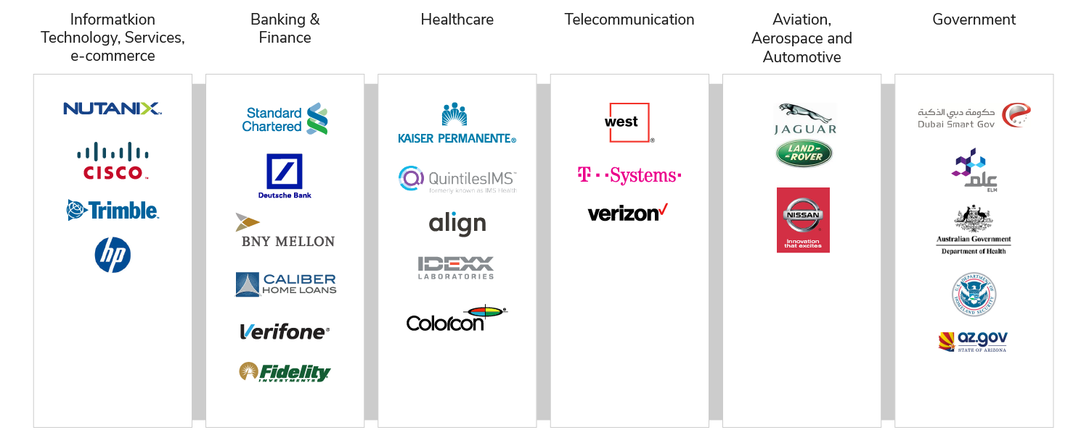
Customer highlights

Slide 60

Nutanix s a leader in hyper-converged systems and the enterprise cloud platform.
WSO2 Identity server is used to provide a seamless - experience for different portals and mobile apps to make their experience simple and seamless as much as possible.
Pivotal in maintaining customer growth

Slide 61

AlmavivA build a master data solution that would offer a central hub for handling highly sensitive personal data of over 1.6 million public sector employees.
WSO2 Identity Server secures the solution by providing authentication and authorization.

Slide 62
Deployment Patterns
cloud . on-premise

Slide 63
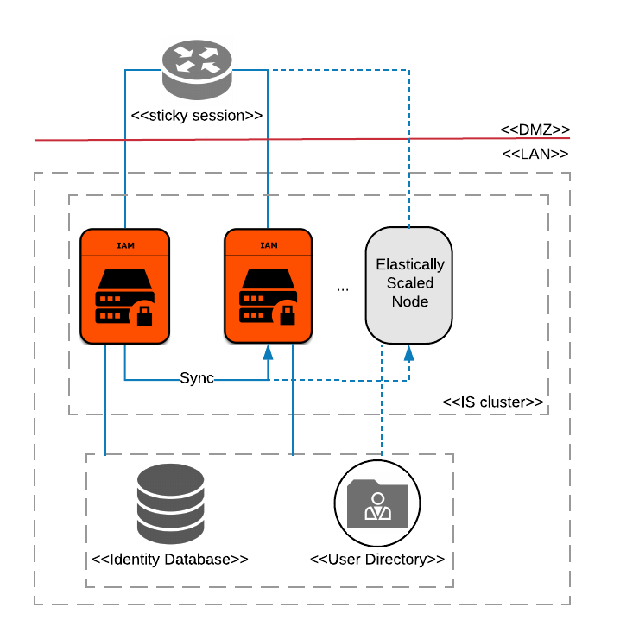
DEPLOYMENT PATTERN 1
Highly available deployment of WSO2 Identity Server
Minimum recommendation is 2 active/active nodes
Deployment for scalability
TPS based scaling (Single node can handle up to 34 million authentication requests per day)
Horizontal auto-scaling via AWS/Azure/Google App Engine or container platforms such as K8S/Docker or OpenShift

Slide 64
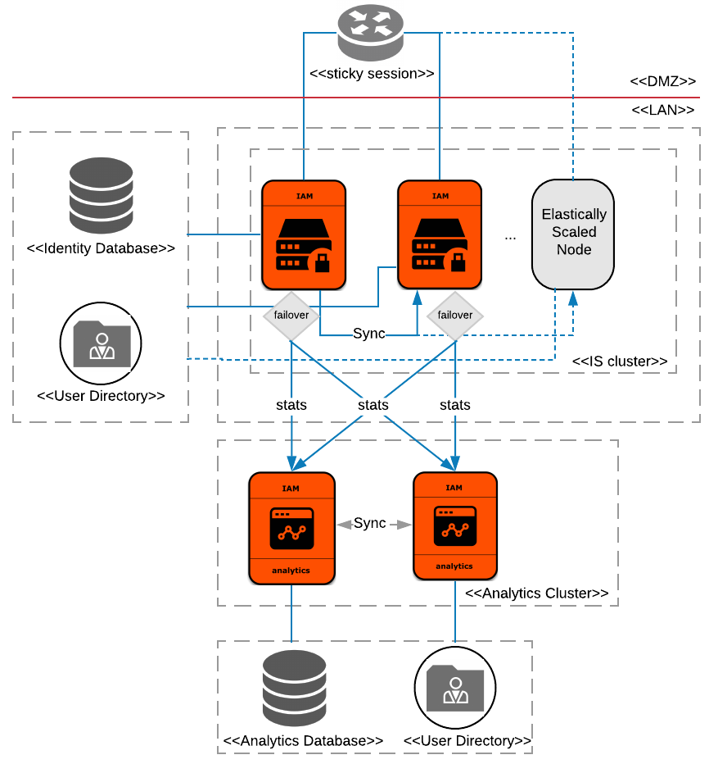
DEPLOYMENT PATTERN 2
Highly available deployment of WSO2 IS and WSO2 IS Analytics
Minimum recommendation is 2 active/active IS nodes and 2 active/passive IS Analytics nodes
Deployment for scalability
TPS Based Scaling (Single IS Analytics node can handle up to 3000 event per second)
IS Analytics doesn’t support horizontal dynamic scaling

Slide 65
SUMMARY
WSO2 Identity Server
Deployment flexibility : public / private cloud, on-premise, hybrid
Support for many open standards for SSO, federation and access control
Identity Framework : More than 40+ extension points/connectors
Comprehensive, extensible, multi-tenant identity layer
Identity analytics
Support for API and Microservices security

